Slide 1


Late Night Tea Gathering
LNTG
By Liiban Nur and Timothy Gulabsing

Slide 2
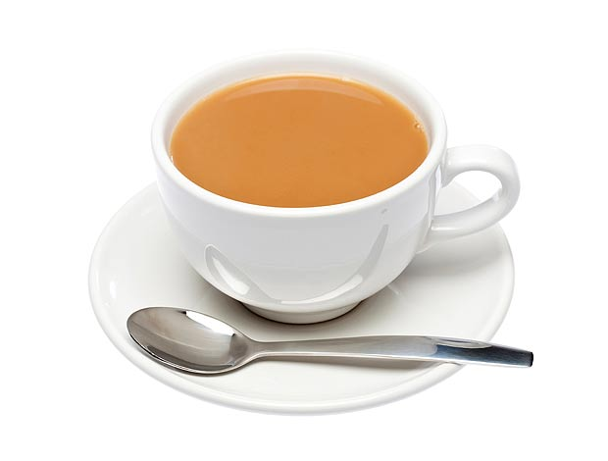
Project Specs
This game was supposed to be a 2D Hack and Slash game with RPG elements such as leveling and stats.

Slide 3

Release Schedule
1.0.0 Load in Basic Environments and Central Character
1.2.0 Implement Movement Controls
1.3.0 Implement Movement animation
1.3.5 Implement Jump controls
1.4.0 Add Jump Animations
1.4.5 Add Environmental Hit Detection
1.5.0 Implement Attack Controls
1.5.5 Implement Attack Animations
1.6.0 Load in Enemies and Add Enemies
1.6.1 Add Enemy Movement Patterns
1.6.2 Add Enemy Collision Detection
1.6.3 Add Enemy Animation
1.6.4 Add Enemy Attack Patterns
1.7.0 Add HUD (Health, Level, EXP Bar Etc.)
1.7.5 Add Sound Effects
1.8.0 Add Environmental Hazards
1.9.0 Add More Detailed Environments
2.0.0 Add additional levels
2.1.0 Finishing Touches

Slide 4

LET’S RUN IT

Slide 5

Bugs
Hit Detection Glitches
Second enemy doesn’t take damage
Unable to jump when the enemy is making contact with the player
Health and Mana drain too quickly

Slide 6

Object Overview
Main.java
Framain.java
PanBoard.java
Sprite.java
Background.java

Slide 7

Challenges
Getting the background to scroll
Adding in the Animations
Getting the player to jump
Death Screen

Slide 8

Advanced Data Structure
More functional Sprite
sprPlayer = new Sprite(sPSprite, 350, 380, 64, 64, true);
GetRect, Mana, Health

Slide 9

Biggest Frustrations
Background Scrolling
Animations
Death Animation

Slide 10
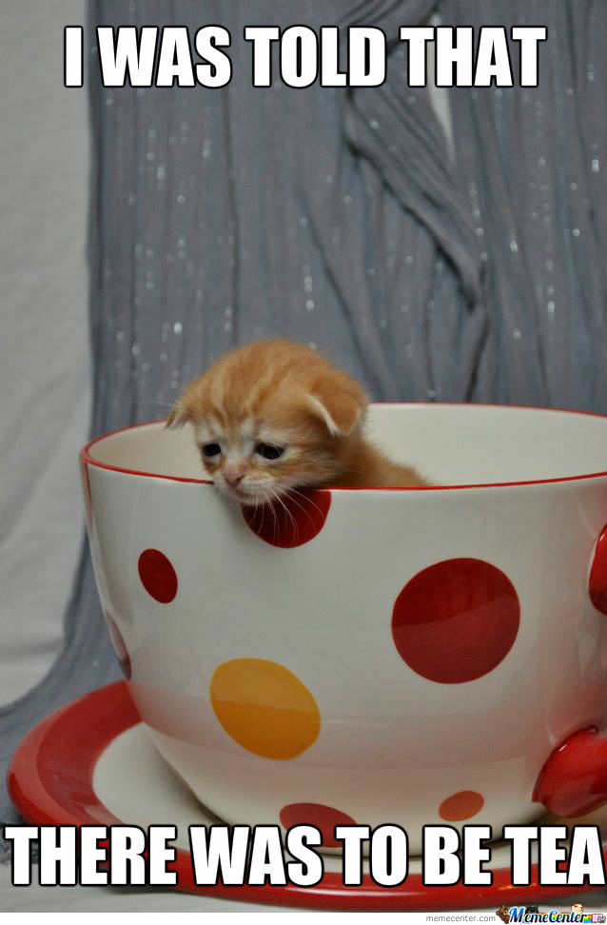
Note to Future Programmers
Try to get a good start on your program to set the pace for the rest of the project
Put focus into making the program more scaleable for the future
Try not to spend too much time on one portion of the program

Slide 11


Questions

Slide 12
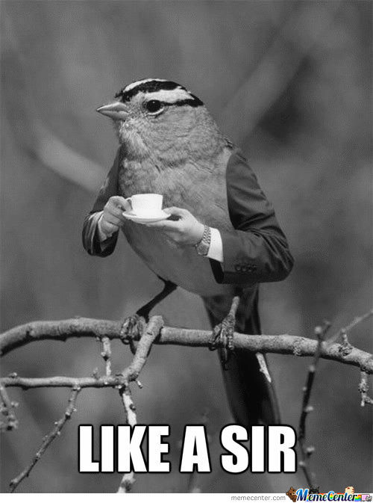
The End

